Slide 1



Computation Flowchart – Transformed Dynamics
System state
Inertia and geometry

Slide 2



Computation Flowchart – Transformed Dynamics
Kinematics – Translation

Slide 3










Computation Flowchart – Transformed Dynamics

Slide 4








Computation Flowchart – Transformed Dynamics
Kinematics – Rotation

Slide 5









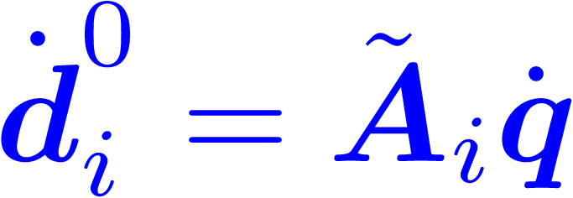
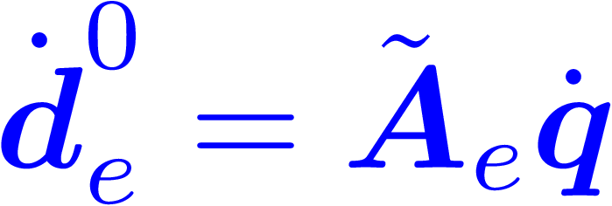


Computation Flowchart – Transformed Dynamics

Slide 6













Computation Flowchart – Transformed Dynamics
Transformed Dynamics – Preliminary

Slide 7

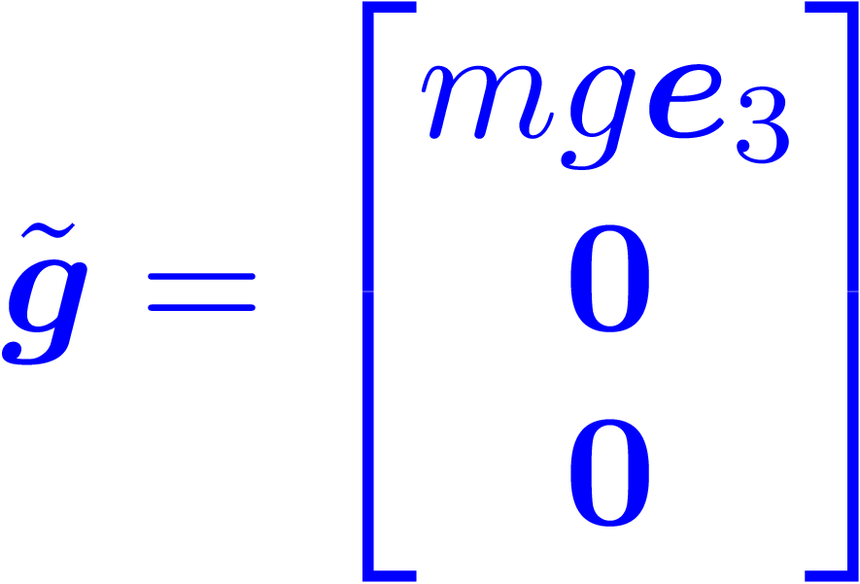
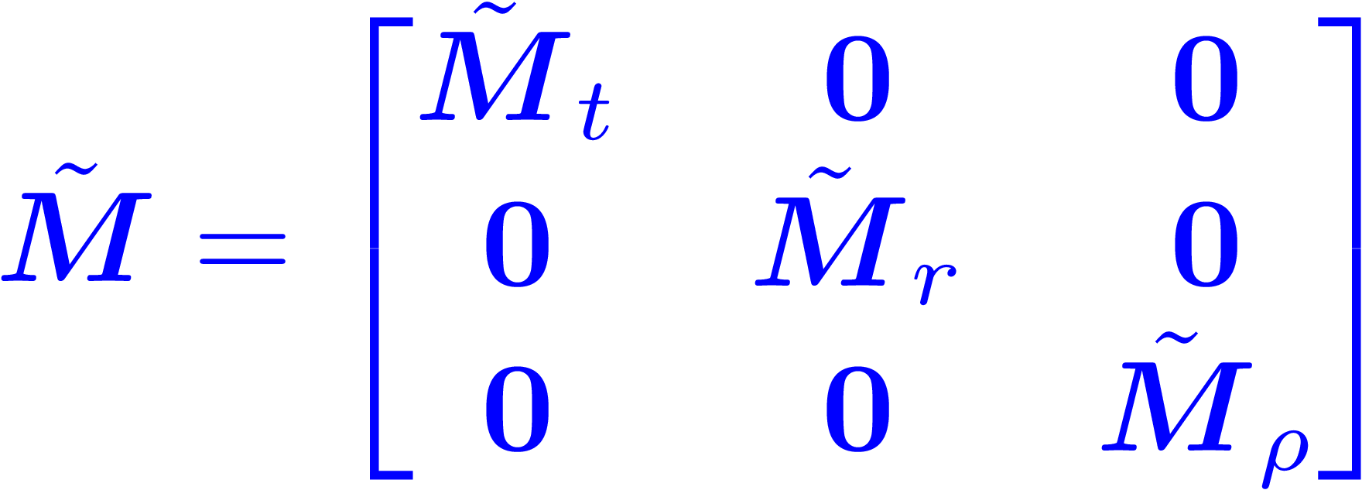
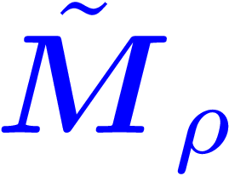
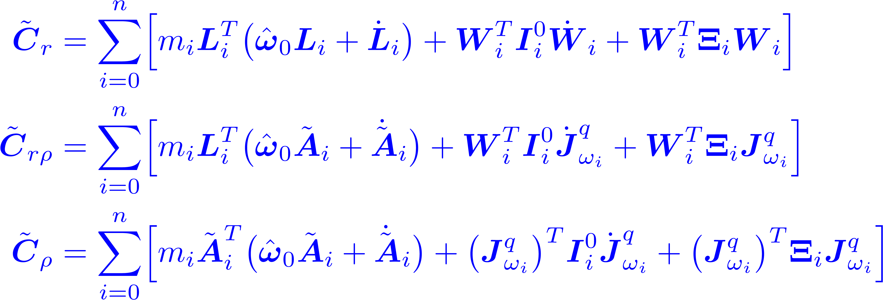
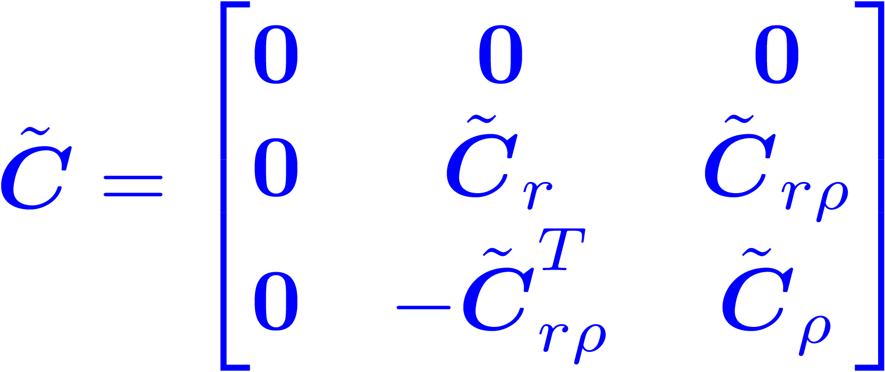
Computation Flowchart – Transformed Dynamics
Transformed Dynamic – Whole-body
will be computed first.

Slide 8





Computation Flowchart – Transformed Dynamics
Transformed Dynamic – End-effector

Slide 9
Computation Flowchart – Transformed Dynamics

